Slide 1
Personality
Notes:
Good afternoon. So we've come to a topic that I think feels to us like intuitively
almost the core of psychology might be about is personality. Why are some things
easy for us and hard for us? Why do we like some things or something else? Why
do people around us behave kindly or rudely, supportively or loyally or whatever?
What can we understand about personality scientifically? So how do psychologists
try to study it in a somewhat systematic fashion?

Slide 2
INDIVIDUALITY
Every person is in certain respects:
Like all other persons,
Like some other persons,
Like no other person.
adapted from Kluckhohn & Murray, 1948
© C. Kluckhohn and H. Murray. All rights reserved. This content is excluded from our Creative Commons license. For more information, see http://ocw.mit.edu/fairuse.
‹#›
Notes:
So I love this quote, because I think it's about individuality, which says, every person
is in certain respects like all other people-- and we think that's true. There's
something deeply similar among all humans, also about psychology, also about our
brains.
Like some other people, that is, there's dimensions of individuality, or like some
other people, like if we're a male or female, if we're this age or that age, this culture
or that culture, like math or don't like math, like vanilla ice cream or don't like ice
cream.
And then finally, we come down to the unique set of things that make you you. And
that's very hard to study, the unique things that make you you. But the second level,
dimensions of individuality, we can study in personality. It's obviously a big one that
we feel in our own lives and around us.

Slide 3
Personality
A set of behavioral, emotional, and cognitive tendencies that people display over time and across situations and that distinguish individuals from one another.
5

Slide 4
Personality
How can we measure?
Interview
Observation
Inventory/Questionnaire
Factor Analysis
Big Five Personality Dimensions

Slide 5
Introduction to Personality Theories
Personality theories help explain individual behavior and traits.
Major perspectives include:
Psychodynamic
Humanistic
Trait
Social-Cognitive

Slide 6
What is Psychodynamic Theory?
Emphasizes unconscious mind, early childhood experiences, and inner conflicts.
Originated with Freud in the late 19th century.
Influential in psychology, literature, and therapy.

Slide 7
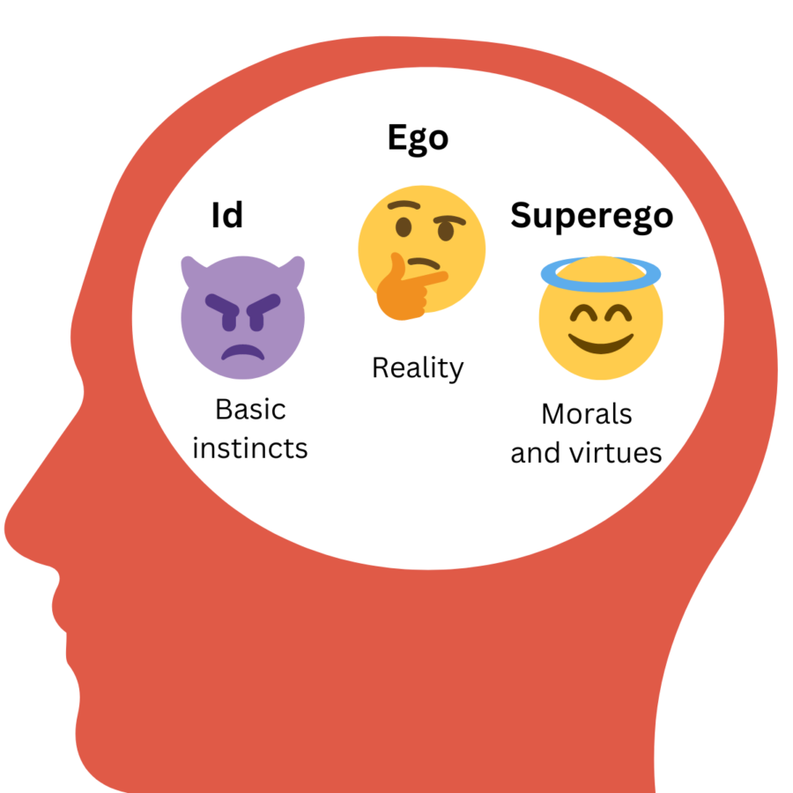
Key Components of Freud’s Theory
Structure of the Mind:
Id – primitive desires, pleasure principle
Ego – rational part, reality principle
Superego – moral standards, conscience
Constant conflict among these parts creates anxiety and behavior.

Slide 8
Ego Defense Mechanisms
Ego defense mechanisms, as described by Sigmund Freud, are unconscious psychological strategies used by the ego to protect itself from anxiety and conflict between the id and superego.
Defense Mechanisms:
Denial: Refusing to acknowledge a distressing event or thought, acting as if it doesn't exist.
Repression: Unconsciously pushing unwanted thoughts, feelings, or memories into the unconscious mind.
Projection: Attributing one's own unacceptable feelings or thoughts to someone else.
Displacement: Redirecting emotions or impulses from a target to a less threatening one.

Slide 9
Ego Defense Mechanisms
Defense Mechanisms:
Regression: Reverting to earlier stages of development in response to stress or conflict.
Sublimation: Channeling unacceptable impulses into socially acceptable activities.
Rationalization: Creating a logical explanation for behavior to reduce anxiety.
Reaction Formation: Overcompensating for an unacceptable feeling or thought by exhibiting the opposite behavior.

Slide 10
Big Five Theory
Introduction
Personality psychology studies individual differences in behavior, emotion, and thought.
The Big Five Theory is the most widely accepted trait model in psychology today.
Also called the Five-Factor Model (FFM).
Origin of the Big Five
Developed through factor analysis of personality traits.
Pioneers: Lewis Goldberg, Costa & McCrae.
Based on analysis of language and personality descriptors.

Slide 11
What Are the Big Five Traits?
The Big Five Personality Traits:
Openness to Experience
Conscientiousness
Extraversion
Agreeableness
Neuroticism

Slide 12
The Big Five Traits
Openness to Experience
Traits: Imaginative, curious, artistic, open to new ideas.
High score: Creative and open-minded.
Low score: Practical, conventional, prefers routine.
Conscientiousness
Traits: Organized, responsible, dependable, goal-oriented.
High score: Efficient, self-disciplined, reliable.
Low score: Impulsive, careless, disorganized.

Slide 13
The Big Five Traits
Extraversion
Traits: Sociable, talkative, assertive, outgoing.
High score: Energetic, enjoys being around people.
Low score: Reserved, quiet, prefers solitude (introverted).
Agreeableness
Traits: Trustworthy, kind, empathetic, cooperative.
High score: Warm, compassionate, helpful.
Low score: Competitive, critical, argumentative.
Neuroticism
Traits: Emotional instability, moodiness, anxiety.
High score: Prone to stress, sensitive, easily upset.
Low score: Calm, emotionally stable, resilient.

Slide 14
Applications of the Big Five
Psychological research
Employee selection
Mental health assessment
Career counseling
Helps predict behaviors like job performance, relationships, well-being.

